Slide 1
Platform Capabilities
1 | User Interface Dashboards, audit trails, and reporting — all centralized QA Processes and explainable
2 | Pluggable Integration Layer A robust integration framework connects to: Databases, APIs, file systems, BI tools, ICMP. Leverage MCP Scheduled QA flows Makes the platform extensible to any enterprise system, Update to the Downstream system from the Platform (MVP2)
3 | Data Layer Store the QA Process transaction for lineage. Build a Datalayer which will act as centralized Chat Interface for any QA process results (MVP2).
Step 1:
Fill the Intake
Step 7: Create Repo and EPLX pipeline to Deploy to Dev
Step 2:
Formulate the SOP
Onboarding
SPARQ Agentic QA Usecase
Step 6:
Validate with Business Team
Step 3: Understanding the Data Source
SPARQ Team
Step 5:
Peform the Proof of Concept
Step 4: Identify the Common Data Agent
QA Team Ownership
Combined

Slide 2
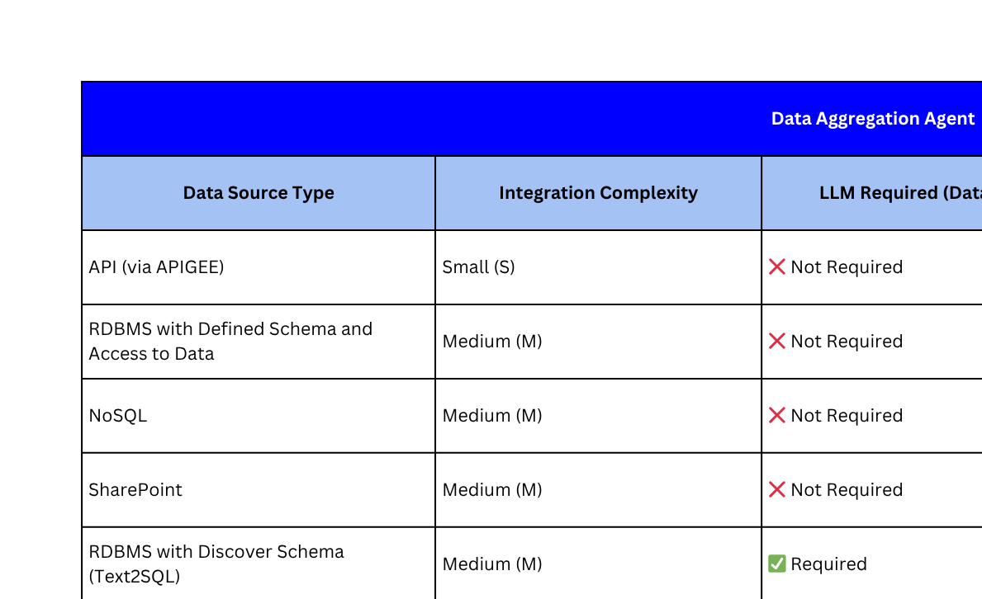

Slide 3
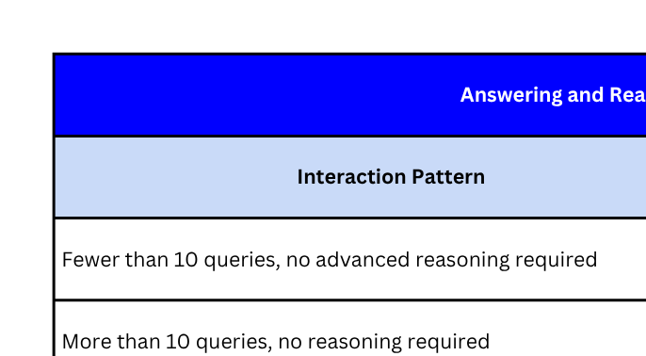
Volume and cognitive depth drive complexity — low-volume, rule-based responses are lightweight; high-volume, interpretive tasks require scalable reasoning via LLM.
This model helps prioritize LLM resource allocation, agent orchestration, and SLA expectations based on operational load and intelligence demands.
Enables a policy-driven approach to manage how and when reasoning agents are triggered across business workflows.

Slide 4
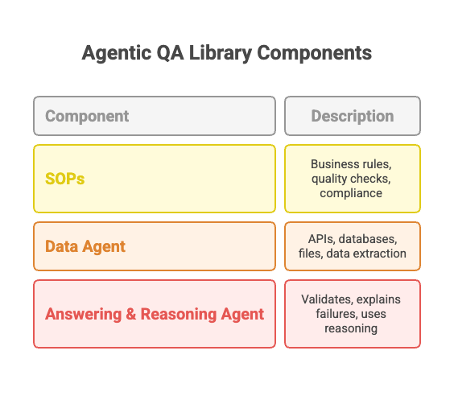
What is Agentic QA Library
The Agentic QA Process Library transforms traditional QA logic into an automated, intelligent module that knows how to validate, where to look, and how to explain — combining SOPs, data connectivity, and AI-driven reasoning in one reusable unit.

